Slide 1
Connected System Design Project (EGE205)
Briefing and discussion before we start the project…

Slide 2
Introduction
Watch the following video… Please take note of the following:
City In Nature
Sustainable Living
Energy
Green Economy
Resilient Future

Slide 3

SG Green Plan
Video Credit: https://www.youtube.com/watch?v=oNFeOl7pW9s&t=331s

Slide 4
The Driving Question for the Project
How can we develop a connected system for a green, liveable and sustainable environment for a better future?
* What is a “Driving Question”?
- A kind of question that can drive us, haunt us, and move us to search for answers.

Slide 5

Introducing The Driving Question
A connected system consists of the following parts interacting with one another to achieve a common purpose.
Sensors and/or actuators
Network
Process and people
Possible areas to source for ideas.
Smart home
Healthcare
City in Nature
Energy Systems
Transportation
Automotive
Autonomous Systems

Slide 6
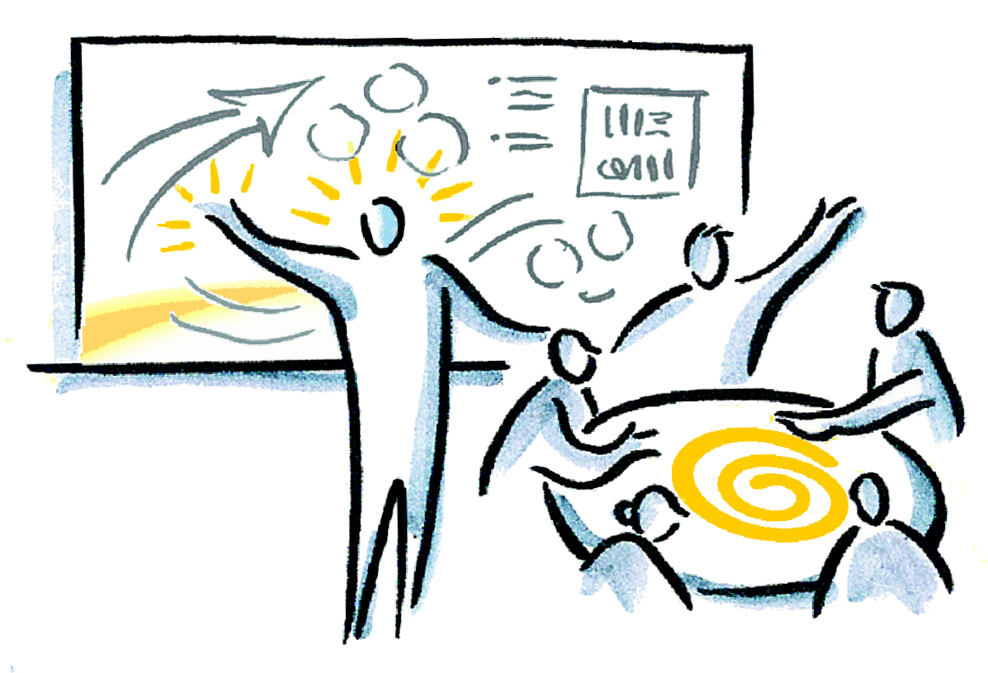
Inquiry Facilitation Session
Proceed to the Jamboard Link on BrightSpace for the Inquiry Facilitation Session
How can we develop a connected system for a green, liveable and sustainable environment for a better future?

Slide 7
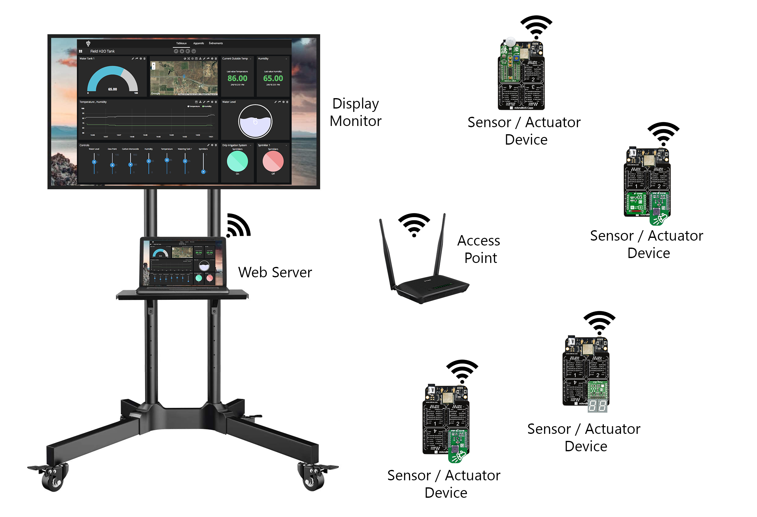



Group Project (by Week 16 and 17)
Project Report (Group) Project Prototype Project Presentation

Slide 8
Rubrics
Rubric is a scoring guide used to evaluate the quality of the assignment, report and project submitted.
Rubrics usually contain evaluative criteria, quality definitions for those criteria at particular levels of achievement, and a scoring strategy.
It is aimed to provide accurate and fair assessment and fostering understanding.
Rubric Assessment
(85%)
Assignment Rubric (25%)
Project Report Rubric (15%)
Project Prototype Rubric (25%)
Project Presentation Rubric (10%)
Critical Core Skill Rubric (10%)

Slide 9

Team Forming
Each team should have at least 4 members if not 5. For example, a group of 23 learners should be divided into 3 teams of 5 members and 2 teams of 4 members. Odd number is preferred in order to better facilitate decision making within the team.
Team allocation will be done based on the criteria which include academic result, gender, related module skills.
However, you can submit a request here on who do you want to be with in a team before the next lesson. We will try our best to grant your request.

Slide 10
Team Forming
Two online form submission is required for a request to be considered. For example, learner A wants to be in the same team as learner B. Both learners A and B needs to submit the online form respectively.
No double request will be accepted for consideration.
All request will be considered based on latest submission.

Slide 11
Tips To Work In A Team
BE PROACTIVE
By taking the first step to get to know your team members.
BE INCLUSIVE
By considering individual’s strength rather than weaknesses of your team members and give each other a learning opportunity.
BE OPEN
By welcoming new challenges and listening to new suggestions from your team members.

Slide 12
Connected System Design Project (EGE205)
End of Briefing and Discussion

